Slide 1
ICSA
London
May 2010
NHS roundtable
2010 Global Reputation Pulse Study – UK Results
The World’s Most Reputable Companies: An Online Study of Consumers in 34 Countries
Copyright © 2010 Reputation Institute. All rights reserved.

Slide 2
Agenda
Welcome and introduction
UK 2010 Global Pulse results of the listed and publicly-owned companies
2010 Pulse results of NHS
Notes:
The goal of todays presentation is to provide you all with a top line understanding of
how the US general public perceives your company
What will make them support your
And how you can create value from your corporate reputation
We will start by introducing ourselves
Then we will give you our insight in how reputation can be used to create value for companies
Then we will present the top line results and insight from the 2009 study
And finally we will outline how you can leverage the insights from this study and our experience in helping companies build strong relations with stakeholders
Throughout feel free to send a question using the text message bar – we will address them as we go along or talk to them at the end

Slide 3

The accountability challenge

Slide 4
UK Global Pulse 2010
Results
(Listed and Private companies)
Reputation Institute UK

Slide 5

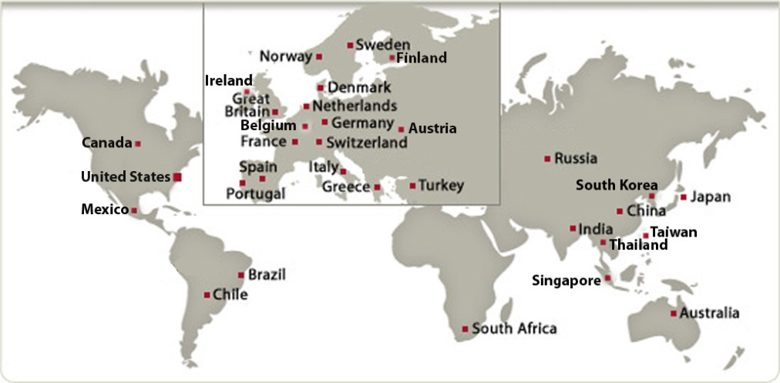
Annual Global Reputation Pulse Study 2010
UK Reputation Pulse 2010
Objective: The Reputation of the largest 150 UK companies
Target: General public, familiar with the companies Online Survey: January and February, 2010
Questionnaire: Global Reputation Pulse model
UK Component of Global Reputation Study (across 34 countries )
24 Industries
Airlines & Aerospace • Automotive • Beverage • Chemicals • Computer • Conglomerate • Construction & Engineering • Consumer Products • Electrical & Electronics • Energy • Financial – Bank • Financial – Diversified Services • Financial – Insurance • Food Manufacturing • Industrial Products • Information & Media • Pharmaceuticals • Raw Materials • Retail – Food • Retail – General • Services • Telecommunications • Transport & Logistics • Utilities

Slide 6
Industry reputations in the UK in 2010
Global Mean
64.2

Slide 7
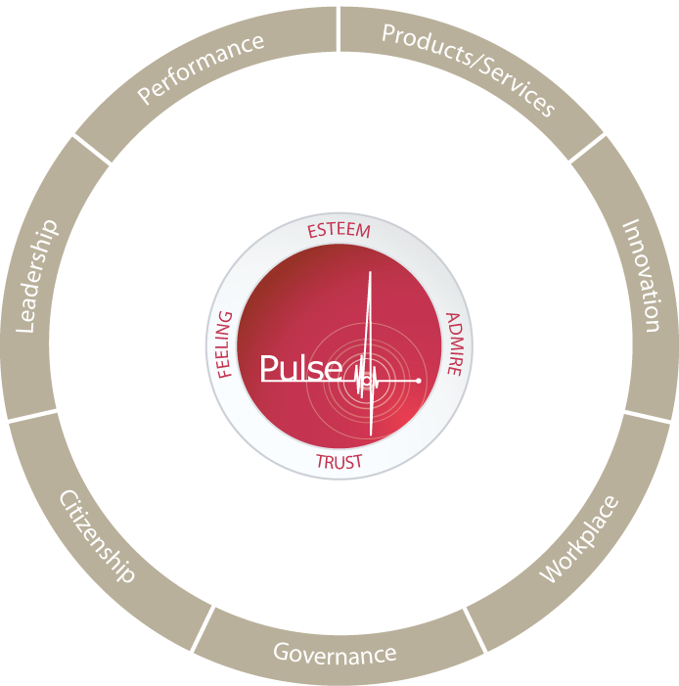
What drives corporate reputation in the UK in 2010?
12.0%
18.4%
12.6%
12.5%
14.0%
13.5%
16.1%

Slide 8










Top 10 reputations in UK in 2010: Privately owned companies
2010
1
(87,19)
2
(83,57)
3
(81,81)
4
(77,65)
5
(76,76)
6
(76,62)
7
(76,22)
8
(76,08)
9
(75,44)
10
(74,48)

Slide 9









Top 10 reputations in UK in 2010: Listed companies
2010
1
(85,86)
2
(84,66)
3
(80,62)
4
(79,64)
5
(78,73)
6
(77,63)
7
(77,24)
8
(76,71)
9
(76,51)
10
(76,24)

Slide 10
Support for the most and least reputable companies in the UK

Slide 11
NHS in 2010

Slide 12
2010 Reputation scores for UK Public Entities

Slide 13
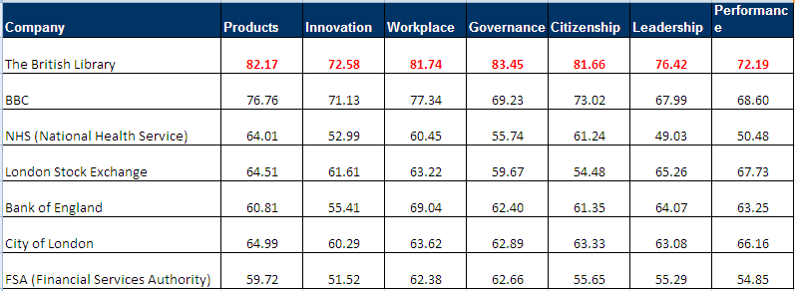
2010 Reputation scores for UK Public Entities - Dimensions

Slide 14
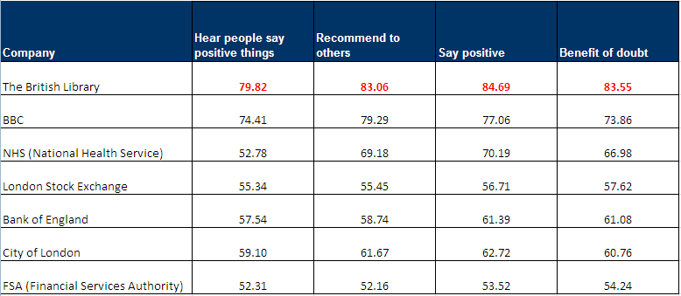
2010 Reputation scores for UK Public Entities – Supportive Behaviors

Slide 15


2010 England Reputation drivers for NHS
10.2%
22.3%
10.8%
15.9%
12.2%
13.0%
15.5%

Slide 16


2010 Reputation scores for NHS - Overall

Slide 17
2010 Reputation scores for NHS - Dimensions

Slide 18
2010 Reputation scores for NHS – Supportive Behaviours

Slide 19
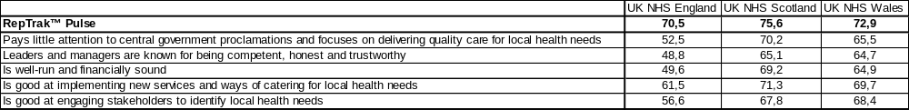
2010 Reputation scores for NHS – Bespoke Attributes

Slide 20
2010 Familiarity (awareness) of NHS

Slide 21
Q&A

