Slide 1
A Cluster view of quality using the General Practice Outcome Standards and Framework
5th July 2012

Slide 2
Purpose of this report
NHS London’s Delivery Group requested a thematic analysis of the general practice outcome standards to be presented at their July meeting
This report provides analysis of achievement against the general practice outcome standards by Cluster and PCT/CCG area that can be used by primary care commissioners to help identify where there may be risks to quality and patient safety
The intended end users of this report are primary care commissioners who can use this alongside their own local intelligence to assess the quality of care provided by their practices
Next steps
Assurance will be sought from the Directors of Primary Care at the Primary Care PLG on 15 August that:
  they have identified those practices where there are risks to the quality and safety of the service patients are receiving by triangulating local intelligence with the general practice outcome standards assessment ratings
  that the necessary steps are being taken, as outlined in the ‘Guidance for Good Performance Management of General Practice’ to support general practice to improve and to address under performing practices
2

Slide 3
Principles
The intended primary users of the GP Practice Outcomes tool are PCT Cluster Primary Care Commissioners who will use this information to help identify where there may be risks to quality and patient safety and to inform the contract review process
The general practice outcome standards provide a high level warning system to be backed-up by robust performance management at a local level
They help to provide an in-depth assessment of local practice performance and enable both the commissioner and GP contactors to reach an objective and rounded view of performance and compliance with their contractual obligations
The general practice outcome standards provide one source of information for managing and monitoring contractors. Any assessment of achievement should be considered alongside other local intelligence. This will build a fuller picture that can enable a more detailed assessment and agreement on what action is required in discussion with individual practices
The Guidance for Good Performance Management of General Practice provides further information on the single London framework for using the contract to support general practice to improve and recommends steps that commissioners of primary medical services could take to address underperforming practices
3

Slide 4
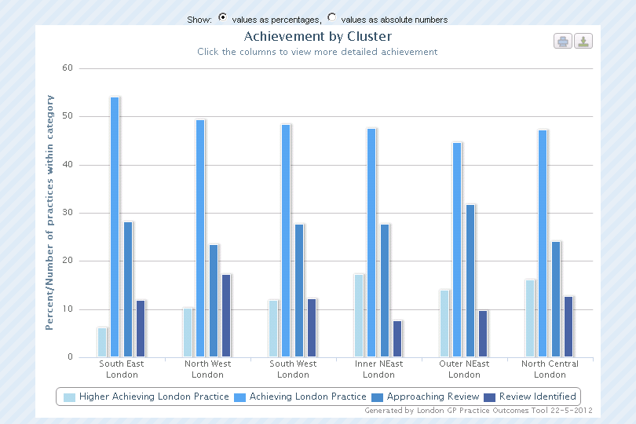
Cluster achievement: percentage of GP practices in each achievement category
4

Slide 5
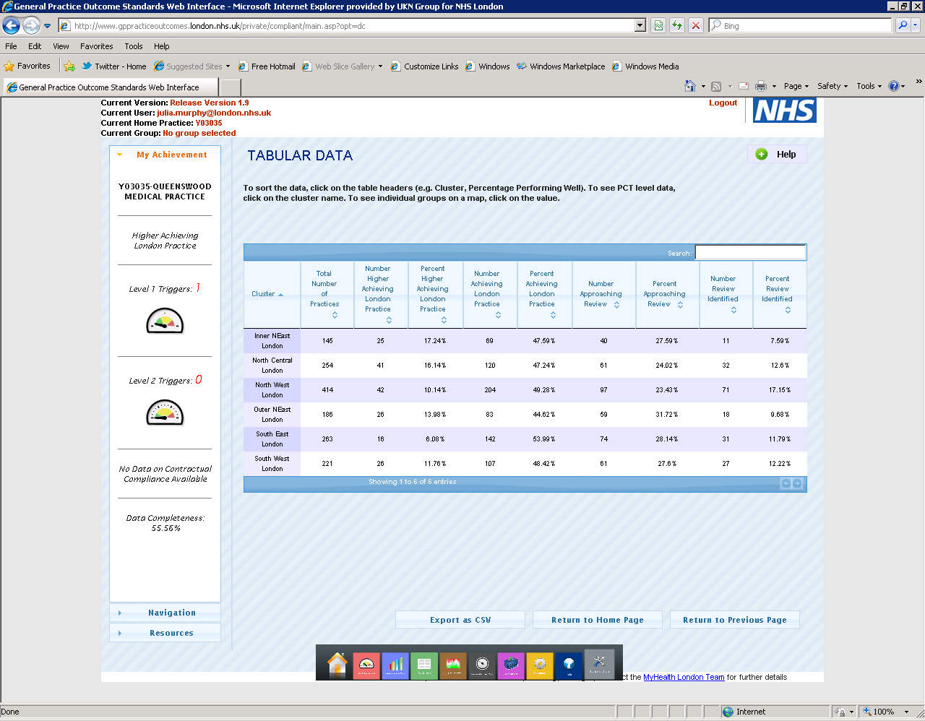
Number and percentage of GP practices in each achievement category for each Cluster
5

Slide 6
  North East London
  (Inner)
  17.24% Higher Achieving London practices
  47.59% Achieving London Practices
  27.59% Approaching Review
  7.59% Review Identified
London PCT Cluster: achievement
  North Central London
  16.14% Higher Achieving London practices
  47.24% Achieving London Practices
  24.02% Approaching Review
  12.6% Review Identified
  North East London
  (Outer)
  13.98% Higher Achieving London practices
  44.62% Achieving London Practices
  31.72% Approaching Review
  9.68% Review Identified
Enfield
Harrow
Barnet
Haringey
Hillingdon
Brent
Waltham
Forest
Redbridge
Camden
Islington
Hackney
Ealing
Havering
  North West London
  10.14% Higher Achieving London practices
  49.28% Achieving London Practices
  23.43% Approaching Review
  17.15% Review Identified
Hammersmith
and Fulham
Westminster
Tower
Hamlets
Barking and Dagenham
City
Newham
Hounslow
Kensington
and Chelsea
Southwark
Richmond
Wandsworth
Lambeth
Greenwich
Lewisham
Bexley
Kingston
Merton
  South East London
  6.08% Higher Achieving London practices
  53.99% Achieving London Practices
  28.14% Approaching Review
  11.79% Review Identified
Sutton
Croydon
Bromley
  South West London
  11.76% Higher Achieving London practices
  48.42% Achieving London Practices
  27.6% Approaching Review
  12.22% Review Identified
  PCT Clusters will need to review the number of triggers for those practices in the ‘approaching review’ category to identify those practices who are borderline ‘review identified’ as this category represents a wide range of achievement, much of which will be within a normal range of variation. The thresholds for approaching review may need to be amended based on this local intelligence to reflect a higher percentage of performing practices.
6
6

Slide 7
Highest deprivation
High deprivation
North Central London: achievement
Low deprivation
Lowest deprivation
Headlines
  This is the Cluster with the second highest level of deprivation in London
  There is not a strong correlation between practice achievement and the index of deprivation using Lower Super Output Areas*
  There is no correlation between achievement and the total number of principled GPs or list size
  Taking a snapshot of three standards there is no correlation between deprivation and practice achievement for childhood immunisations or identifying patients with diabetes and a weak correlation with A&E attendances
  Practices in more deprived areas are not more likely to be failing
ENFIELD
BARNET
HARINGEY
CAMDEN
ISLINGTON
Percentage and (No.) PCT | Higher Achieving | Achieving | Approaching review | Review Identified | PCO Average 2010 IMD score¹
Haringey | 21.15 (11) | 36.54 (19) | 21.15 (11) | 21.15 (11) | 36.1
Islington | 8.11 (3) | 56.76 (21) | 32.43 (12) | 2.7 (1) | 35.87
Enfield | 25 (14) | 46.43 (26) | 19.64 (11) | 8.93 (5) | 26.06
Camden | 2.5 (1) | 42.5 (17) | 30 (12) | 25 (10) | 25.43
Barnet | 17.39 (12) | 53.62 (37) | 21.74 (15) | 7.25 (5) | 16.64
  Note on GP practice achievement data
  There is no cervical cytology data available for Barnet, Enfield and Haringey practices.
  There is no childhood vaccinations data available for Enfield, Haringey and Islington practices.
*Lower Super Output Areas have between 1000 and 3000 people living in them with an average population of 1500 people. In most cases, these are smaller than wards, thus allowing the identification of small pockets of deprivation.
Scores of Index of Multiple Deprivation for Primary Care Organisations have been published by the Department for Communities and Local Government and can be accessed on their website: http://www.communities.gov.uk/documents/statistics/xls/1981203.xls
*
7

Slide 8
Highest deprivation
North East London: Achievement
High deprivation
Low deprivation
Lowest deprivation
Headlines
  This is the Cluster with the greatest deprivation in London
  There is not a strong correlation between practice achievement and the index of deprivation for INEL or ONEL
  There is no correlation between achievement and the total number of principled GPs or list size for INEL or ONEL
  There is a weak correlation between deprivation and practice achievement for childhood immunisations and identifying patients with diabetes for INEL and ONEL
  There is no correlation between deprivation and practice level A&E attendances for INEL or ONEL
  Practices in more deprived areas are not more likely to be failing
WALTHAM FOREST
REDBRIDGE
CITY & HACKNEY
NEWHAM
BARKING & DAGENHAM
HAVERING
TOWER HAMLETS
Percentage and (No.) PCT | Higher Achieving | Achieving | Approaching review | Review Identified | PCO Average 2010 IMD score¹
Newham | 9.38 (6) | 45.31 (29) | 35.94 (23) | 9.38 (6) | 41.84
City and Hackney | 24.44 (11) | 48.9 (22) | 20 (9) | 6.67 (3) | 41.28
Tower Hamlets | 22.22 (8) | 50 (18) | 22.22 (8) | 5.56 (2) | 39.59
Waltham Forest | 6.52 (3) | 43.48 (20) | 39.13 (18) | 10.87 (5) | 35.44
Barking & Dagenham | 10 (4) | 40 (16) | 42.5 (17) | 7.5 (3) | 34.2
Redbridge | 8.51 (4) | 55.32 (26) | 25.53 (12) | 10.64 (5) | 20.37
Havering | 28.3 (15) | 39.62 (21) | 22.64 (12) | 9.43 (5) | 16.63
  Note on GP practice achievement data
  There is no childhood vaccinations data available for C&H practices.
8

Slide 9
Highest deprivation
South East London: achievement
High deprivation
Low deprivation
Lowest deprivation
Headlines
  This is the Cluster with the third highest level of deprivation in London
  There is no correlation between practice achievement and the index of deprivation
  There is no correlation between achievement and the total number of principled GPs or list size
  Taking a snapshot of three standards there is a weak correlation between deprivation and practice achievement for childhood immunisations, and identifying patients with diabetes and no correlation with A&E attendances
  Practices in more deprived areas are not more likely to be failing
SOUTHWARK
LAMBETH
LEWISHAM
GREENWICH
BEXLEY
BROMLEY
Percentage and (No.) PCT | Higher Achieving | Achieving | Approaching review | Review Identified | PCO Average 2010 IMD score¹
Greenwich | 13.33 (6) | 62.22 (28) | 17.78 (8) | 6.67 (3) | 31.94
Lambeth | 1.96 (1) | 47.06 (24) | 37.25 (19) | 13.73 (7) | 31.24
Lewisham | 2.27 (1) | 47.73 (21) | 34.09 (15) | 15.91 (7) | 30.97
Southwark | 0 (0) | 48.94 (23) | 31.91 (15) | 19.15 (9) | 29.73
Bexley | 7.14 (2) | 60.71 (17) | 25 (7) | 7.14 (2) | 16.71
Bromley | 12.5 (6) | 60.42 (29) | 20.83 (10) | 6.25 (3) | 14.95
  Note on GP practice achievement
  There is no cervical cytology data available for Lewisham. Practices.
9

Slide 10
Highest deprivation
North West London: achievement
High deprivation
Low deprivation
Headlines
  This is the Cluster with fourth highest deprivation in London.
  There is no correlation between practice achievement and the index of deprivation.
  There is no correlation between achievement and the total number of principled GPs or list size
  Taking a snapshot of three standards there is a weak correlation between deprivation and practice achievement for childhood immunisations and no correlation with deprivation and identifying patients with diabetes or A&E attendances
  Practices in more deprived areas are not more likely to be failing
Lowest deprivation
HARROW
HILLINGDON
BRENT
EALING
WESTMINSTER
H&F
K&C
HOUNSLOW
Percentage and (No.) PCT | Higher Achieving | Achieving | Approaching review | Review Identified | PCO Average 2010 IMD score¹
Brent | 7.14 (5) | 38.57 (27) | 28.57 (20) | 25.71 (18) | 30.5
Hammersmith and Fulham | 3.23 (1) | 51.61 (16) | 22.58 (7) | 22.58 (7) | 27.48
Ealing | 9.76 (8) | 54.88 (45) | 19.51 (16) | 15.85 (13) | 25.01
Westminster | 12 (6) | 44 (22) | 26 (13) | 18 (9) | 24.59
Kensington and Chelsea | 2.38 (1) | 30.95 (13) | 38.1 (16) | 28.57 (12) | 23.31
Hounslow | 5.56 (3) | 57.41 (31) | 22.22 (12) | 14.81 (8) | 21.84
Hillingdon | 30.61 (15) | 57.14 (28) | 8.16 (4) | 4.08 (2) | 19.81
Harrow | 8.33 (3) | 61.11 (22) | 25 (9) | 5.56 (2) | 15.49
CLUSTER AVERAGE | 10.14(42) | 49.28(204) | 23.43(97) | 17.15(71) | 23.5
  Note on GP practice achievement data
  There is no cervical cytology data available for Ealing, Hillingdon and Hounslow practices.
10

Slide 11
Highest deprivation
South West London: performance, quality and safety
High deprivation
Low deprivation
Lowest deprivation
Headlines
  This is the Cluster with lowest deprivation in London
  There is no correlation between practice achievement and the index of deprivation
  There is no correlation between achievement and the total number of principled GPs or list size
  Taking a snapshot of three standards there is a weak correlation between deprivation and practice achievement for childhood immunisations and no correlation with deprivation and identifying patients with diabetes or A&E attendances
  Practices in more deprived areas are not more likely to be failing
RICHMOND & TWICKENHAM
WANDSWORTH
KINGSTON
MERTON
SUTTON
CROYDON
Percentage and (No.) PCT | Higher Achieving | Achieving | Approaching review | Review Identified | PCO Average 2010 IMD score¹
Croydon | 4.76 (3) | 47.62 (30) | 26.98 (17) | 20.63 (13) | 22.76
Wandsworth | 6.82 (3) | 43.18 (19) | 31.82 (14) | 18.18 (8) | 21.46
Sutton and Merton | 14.81 (8) | 55.56 (30) | 25.93 (14) | 3.7 (2) | 14.98
Kingston | 14.29 (4) | 46.43 (13) | 28.57 (8) | 10.71 (3) | 11.66
Richmond and Twickenham | 25 (8) | 46.88 (15) | 25 (8) | 3.13 (1) | 10.12
11

