Slide 1
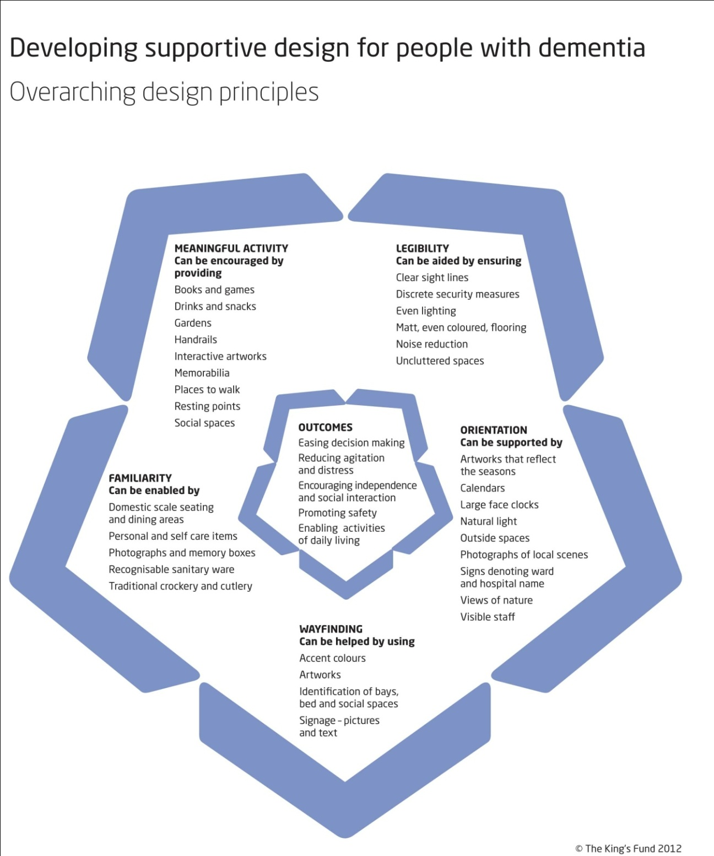
Notes:
Figure 1 Overarching design principles

Slide 2
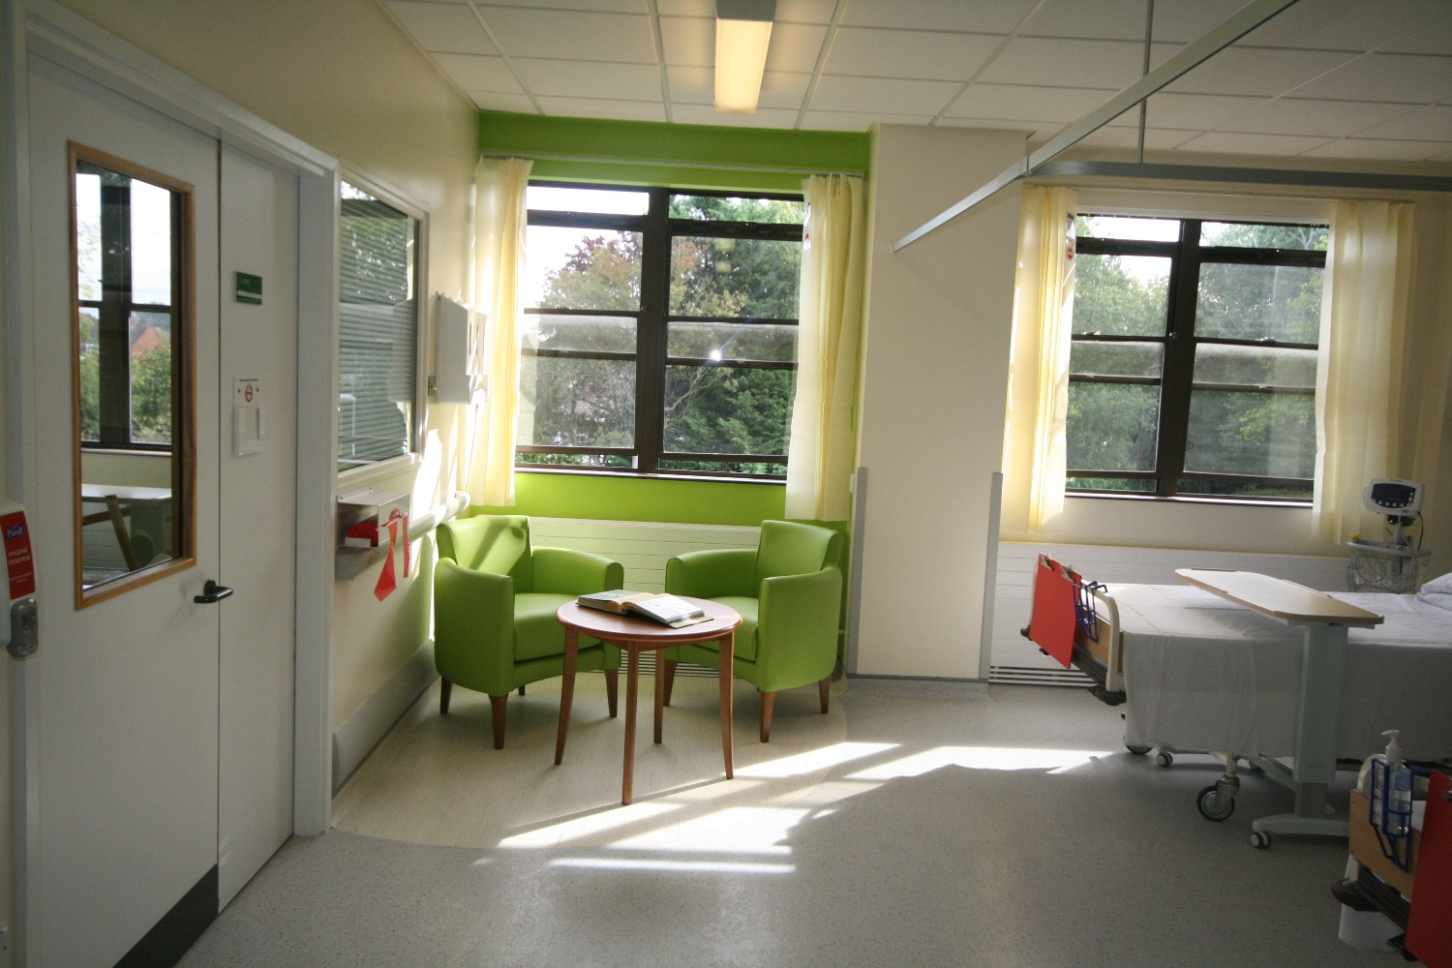
Notes:
Illustration 1 Post redesign - seating area using accent colour to assist wayfinding

Slide 3
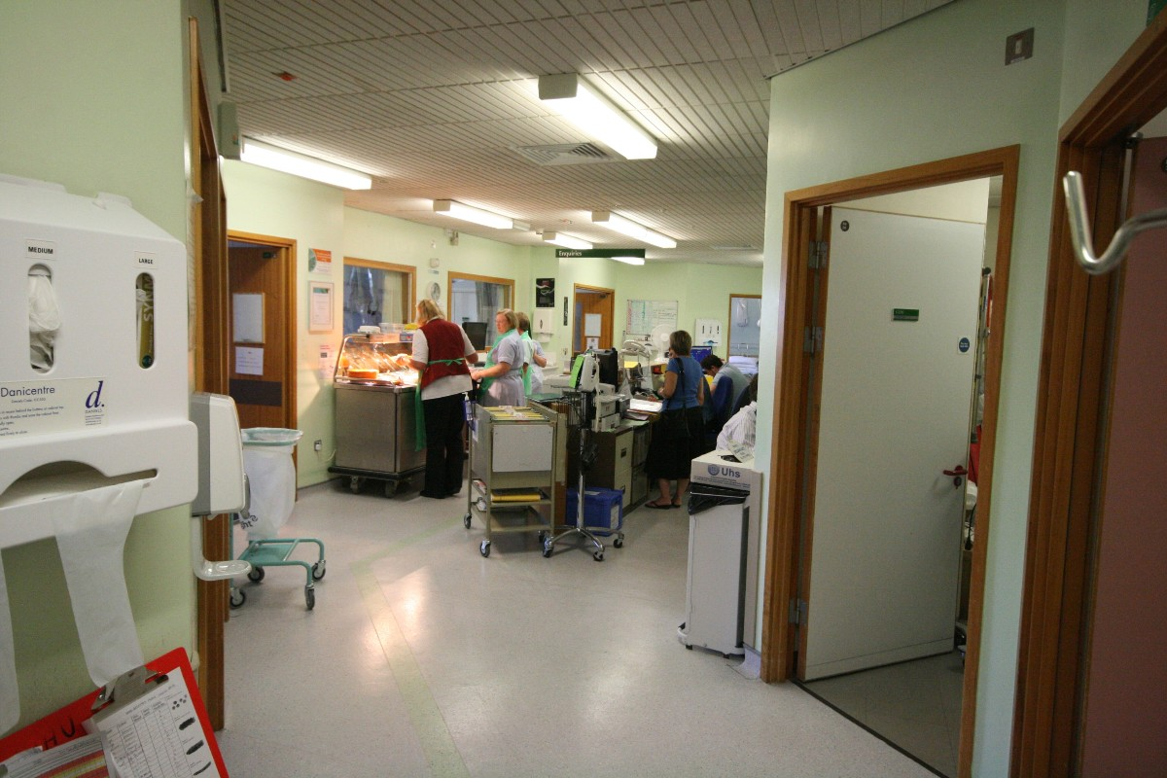
Notes:
Illustration 2 Pre redesign - typical nurses' station in a nucleus ward

Slide 4
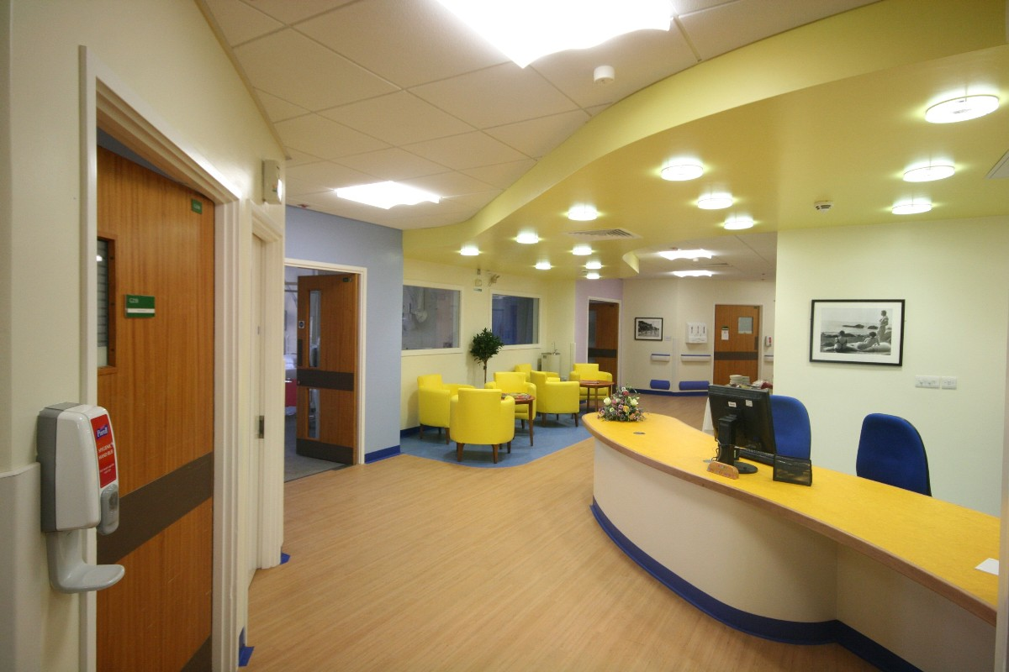
Notes:
Illustration 3 Post redesign - reception desk and seating area for patients

